Slide 1

Improving Claims Process with Data Science
A Data-Driven Approach to
Enhance Cost Estimation and Complex Claim Identification
Satya Vivek Pabolu, Senior Data Scientist

Slide 2



Contents
Introduction
What is the problem?
Data Overview: Any historical data?
Data Exploration: Let’s dive into exploring the data
Data Preparation: Prepare data to address business needs
Cost Estimation Model
Overview
Model Performance: A technical explanation
Feature Importance: So what’s important...
Complex Claims Detection
Overview
Model Performance: A technical explanation
Business Impact: So what is the business impact?
Next Steps... Exploring Ideas Out Loud
Conclusion
Summary
End

Slide 3


Introduction
Business owner is keen to understand the opportunities to improve existing claims processes using Data Science methods
Accurate cost estimation for claims.
Early detection of complex claims

Slide 4

What is the problem?
Business Challenges
Inaccurate Cost Estimates: Current estimates are inconsistent and frequently revised.
Complex Claims Identification: Early detection and proper triaging of complex claims are difficult.

Slide 5

The Data
Explore and Analyse

Slide 6
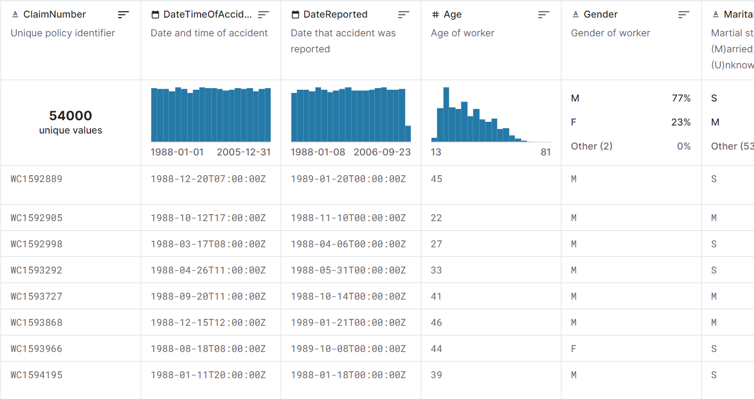
Any historical data?
Key Field Categories:
Claim details (e.g., accident date, report date)
Worker demographics (e.g., age, gender)
Employment details (e.g., weekly wages, work hours)
Claim costs (initial and ultimate)
Usability
9.71
License
CC0: Public Domain
Expected update frequency
Never
Dataset: Easy peasy - it's lemon squeezy
Historical claims data with 54,000 records.

Slide 7
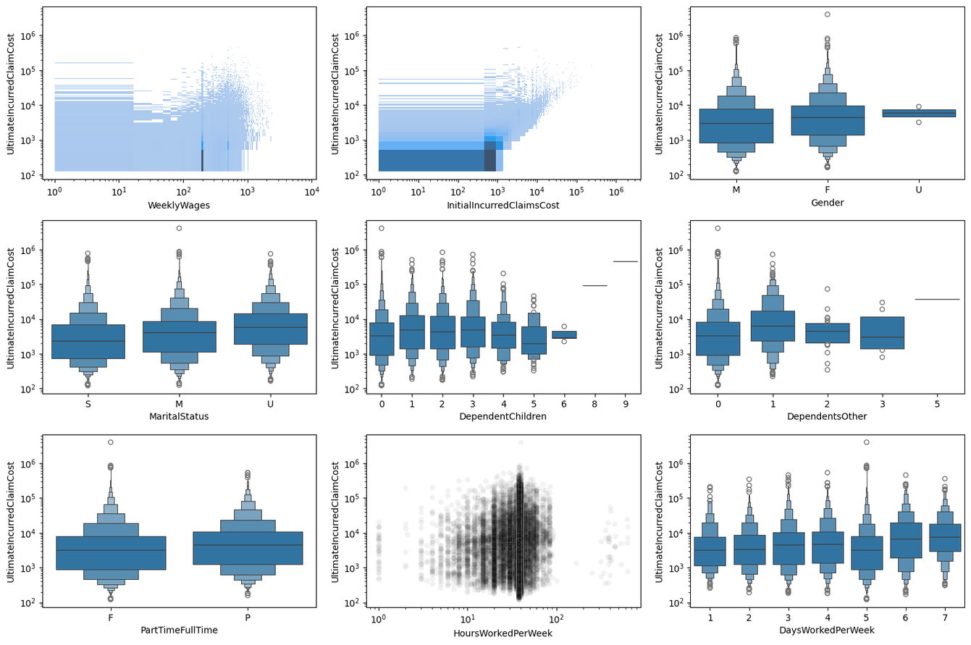
Let’s dive into exploring the data.
Data Distribution against Ultimate Incurred Claim Cost
Dataset: Historical claims data with 54,000 records.
Key Fields:
Claim details (e.g., accident date, report date)
Worker demographics (e.g., age, gender)
Employment details (e.g., weekly wages, work hours)
Claim costs (initial and ultimate)

Slide 8
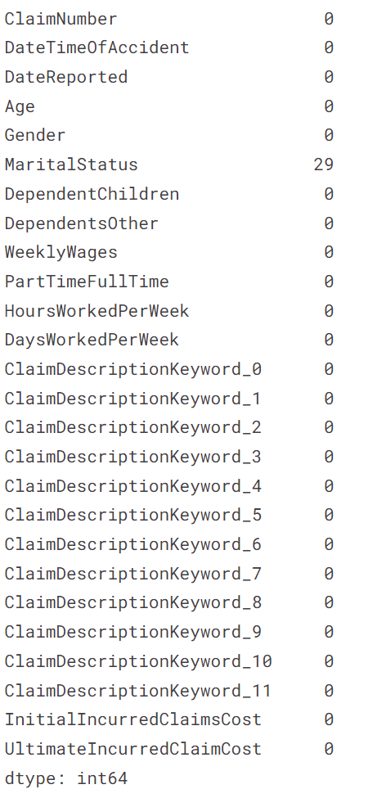
Prepare data to address business needs
Investigate for Missing Values
Steps Taken:
Missing Values: Filled using the mean of surrounding values.
Date Conversion:
Converted accident and report dates to DateTime format.
Identified and updated the Claim Numbers. It's a unique value so will not be included in prediction.
Feature Engineering:
Calculated days between accident and report.
Extracted Year, Month and Day from DateTimeOfAccident, and DateReported.
Visual Insight:
Example table showing cleaned and processed data.
Visualise the data distribution, skew, and correlation.

Slide 9

The Cost Estimation Model
Accurate cost estimation for claims using AI and Machine Learning

Slide 10
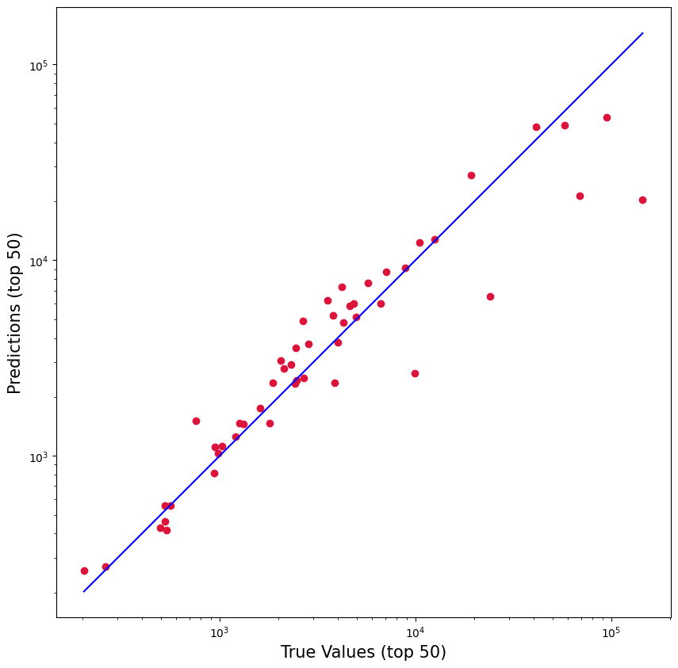
Overview
Objective: Predict the ultimate incurred claim cost
Approach:
Tested with various Learning algorithms (eg., Linear Regression, Decision Tree, Fastai, Random Forest, and Boosting)
The Fastai and Random Forest Regressor performed much better.
Trained and Tested on historical data to learn patterns.
Visual Insight: Graph showing actual vs. predicted costs.

Slide 11
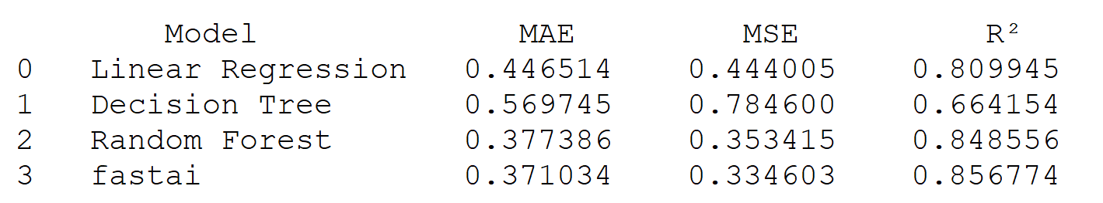
Model Performance A technical explanation
Machine Learning Models performance against the preprocessed data
Evaluation Metrics:
Mean Absolute Error (MAE)
Mean Squared Error (MSE)
Coefficient of Determination (R²)
Results: Achieved lower error rates, indicating more accurate estimates.
Visual Insight: Bar chart comparing model performance metrics.

Slide 12
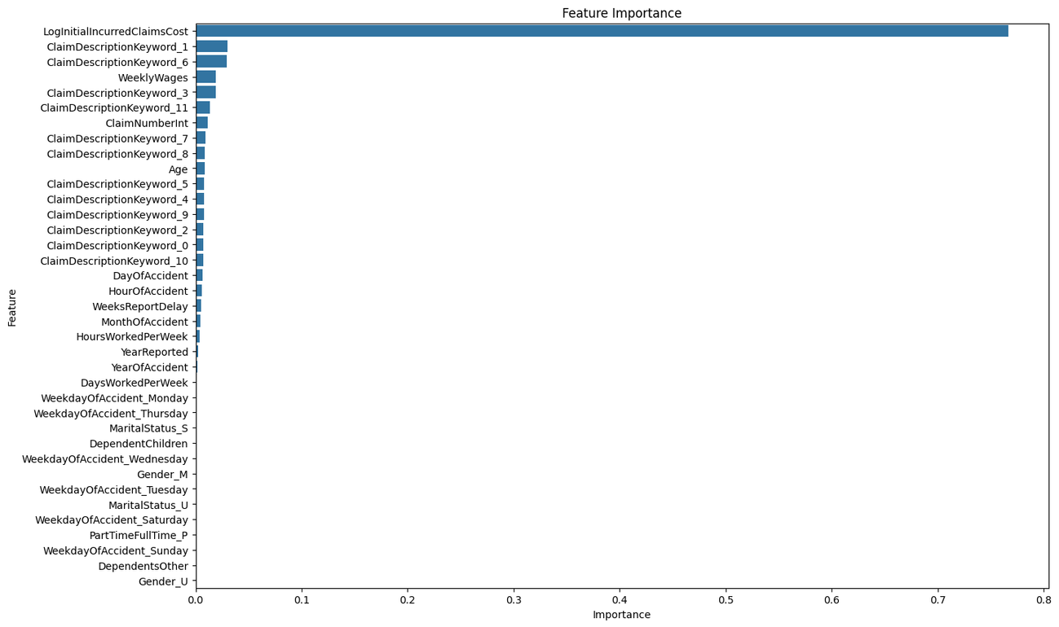
So what’s important...
Feature Importance
Key Drivers:
Initial Incurred Claim costs, Weekly wages, Claim Numbers, age, and time between accident and report.
Visual Insight: Bar chart of feature importances from the model.

Slide 13

The Complex Claims Detection Model
Early detection of complex claims using AI and Machine Learning

Slide 14
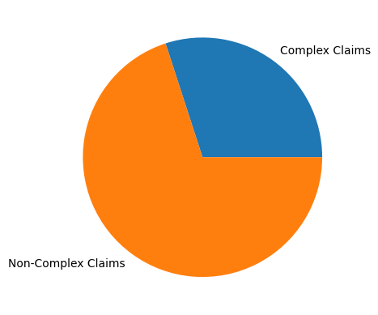
Overview
Objective: Identify complex claims early for better handling.
Definition: Complex claims identified as those above the 75th percentile in cost.
Approach:
Used Logistic Regression for classification.
Defined "complex" based on cost threshold.
Visual Insight: Pie chart showing the proportion of complex vs. non-complex claims.

Slide 15
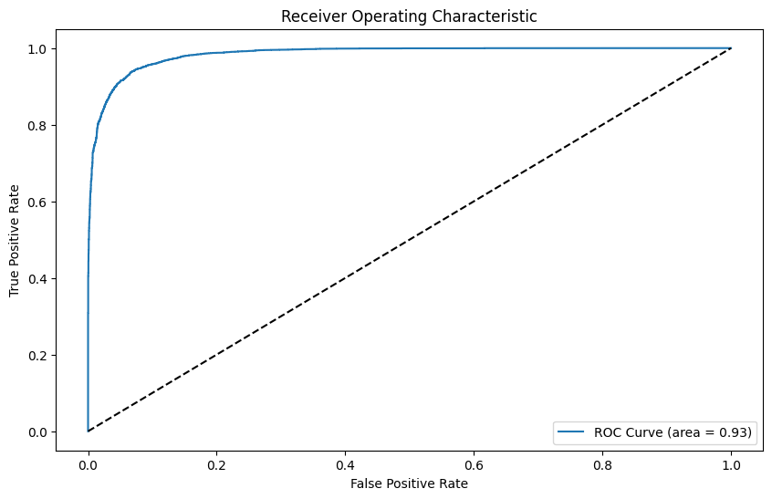
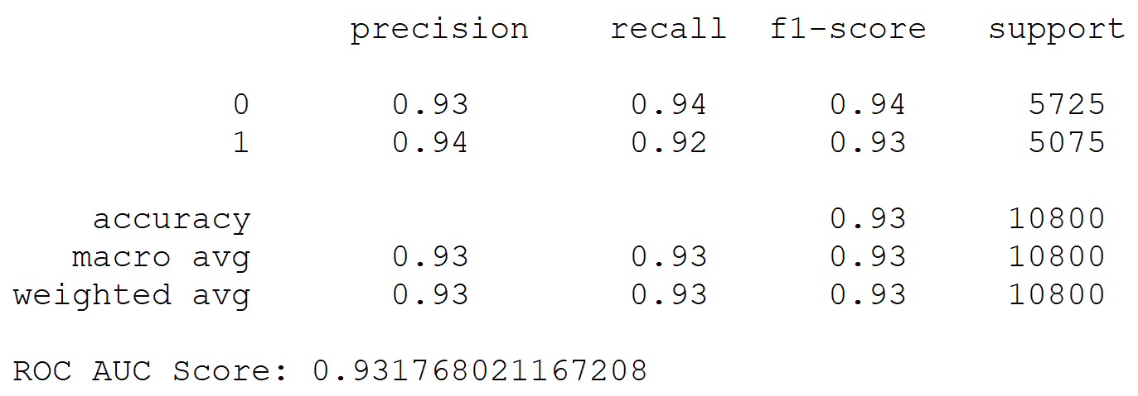
Model Performance A technical explanation
Evaluation Metrics:
Classification report (precision, recall, F1-score)
ROC AUC Score
Results: High accuracy and reliable detection of complex claims.
Visual Insight: ROC curve showing model performance.

Slide 16

So what is the Business Impact?
Benefits:
Accurate Reserves: Better cost estimates lead to more precise financial planning.
Efficient Claim Handling: Early detection of complex claims ensures experienced handlers manage them.
Visual Insight: Infographic summarizing key benefits.

Slide 17

Next steps?
Implement and Improve

Slide 18

Exploring Ideas Out Loud
Implementation:
Integrate models into the claims process.
Build a Dashboard for Business Insights.
Bring in the Cloud to Streamline the process.
Train claims handlers on using the new system.
Continuous Improvement:
Regularly update models with new data.
Introduce Generative AI (GenAI)
Monitor performance and adjust as needed.

Slide 19

Demo
A Generative AI flavor to the data

Slide 20

Conclusion
A Retro

Slide 21

Summary
Data-driven models can significantly improve claims process efficiency.
Accurate cost estimates and early detection of complex claims provide substantial business value.

Slide 22

Thank you
Any QnA?

